Slide 1

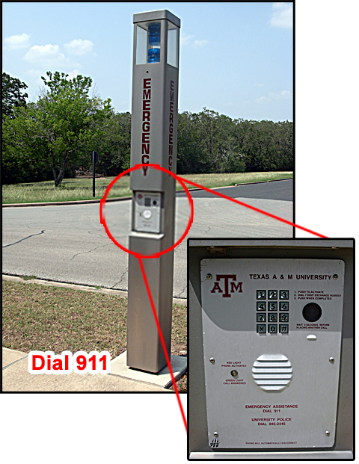
Texas A&M Emergency Phones
Team Leader: Tanner Fritsch Tannerfritsch@tamu.edu
Team Members: William Wallace WWallace14@tamu.edu
Sarah Hall Sarahbhall@tamu.edu
https://www.google.com/search?q=texas+a%26m+emergency+phone&source=lnms&tbm=isch&sa=X&ved=0ahUKEwj5xofkws3TAhUIx2MKHTD0BbEQ_AUIDSgE&biw=1655&bih=927#imgrc=QWiWuDDqRwyhNM:

Slide 2
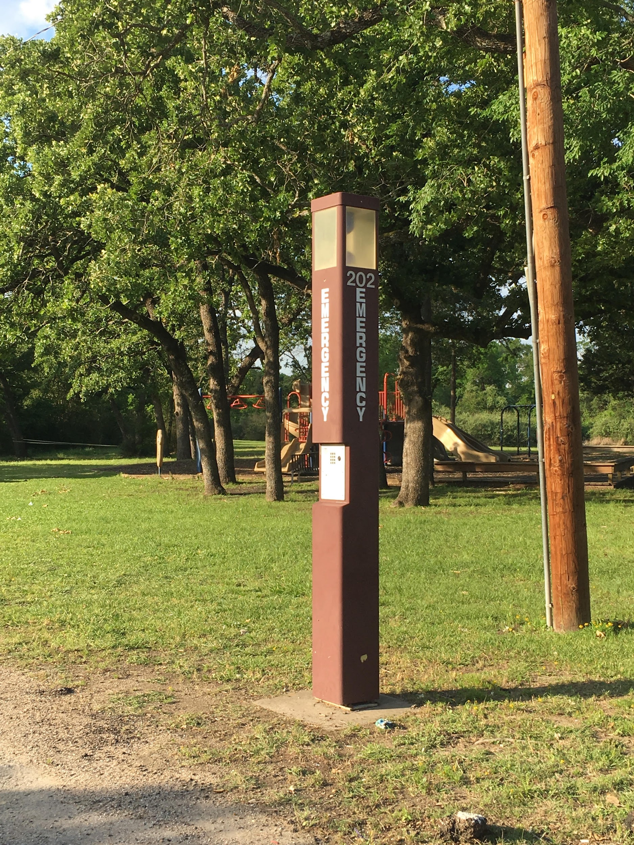
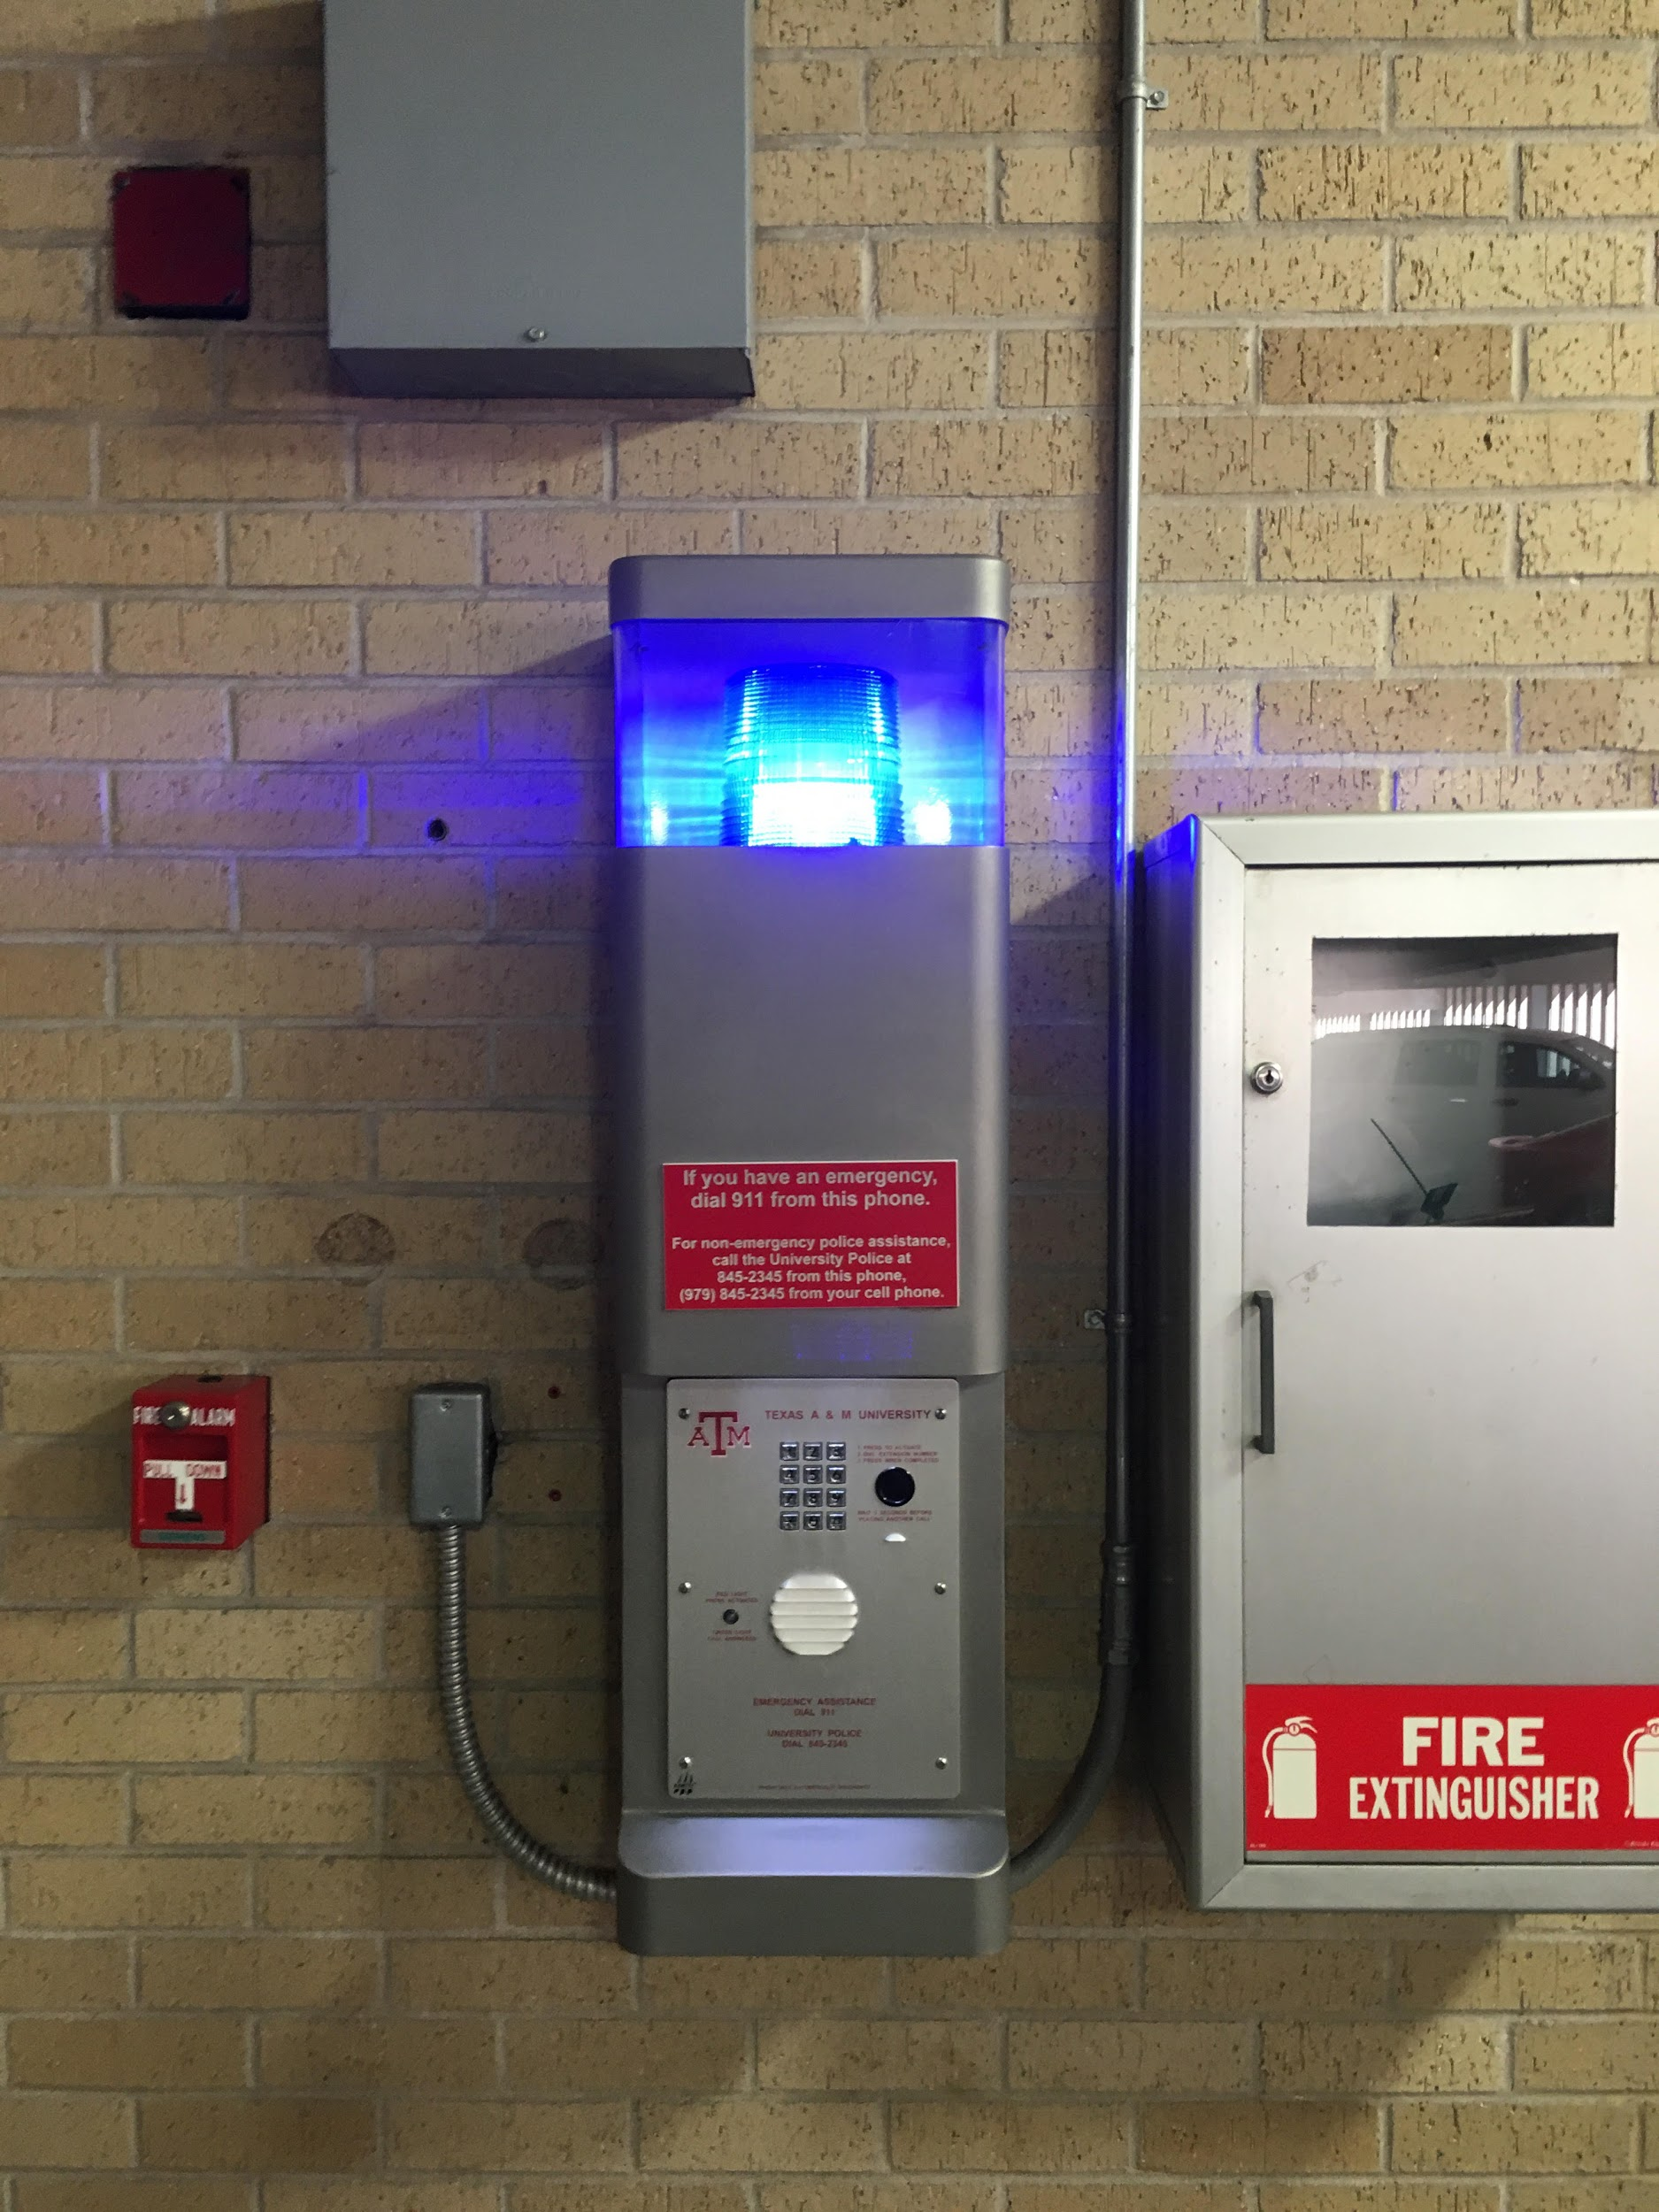
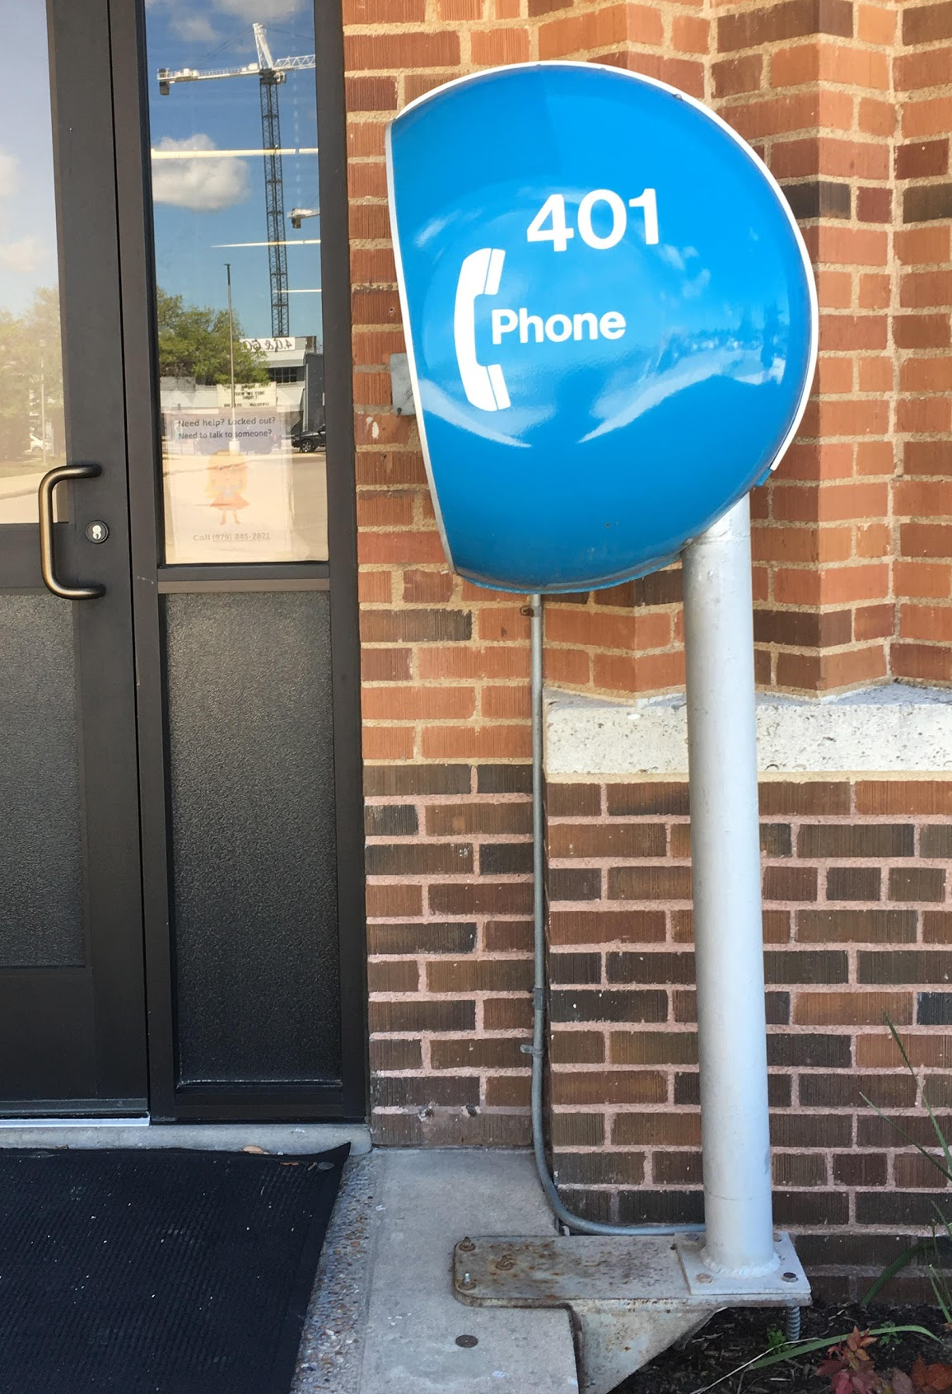
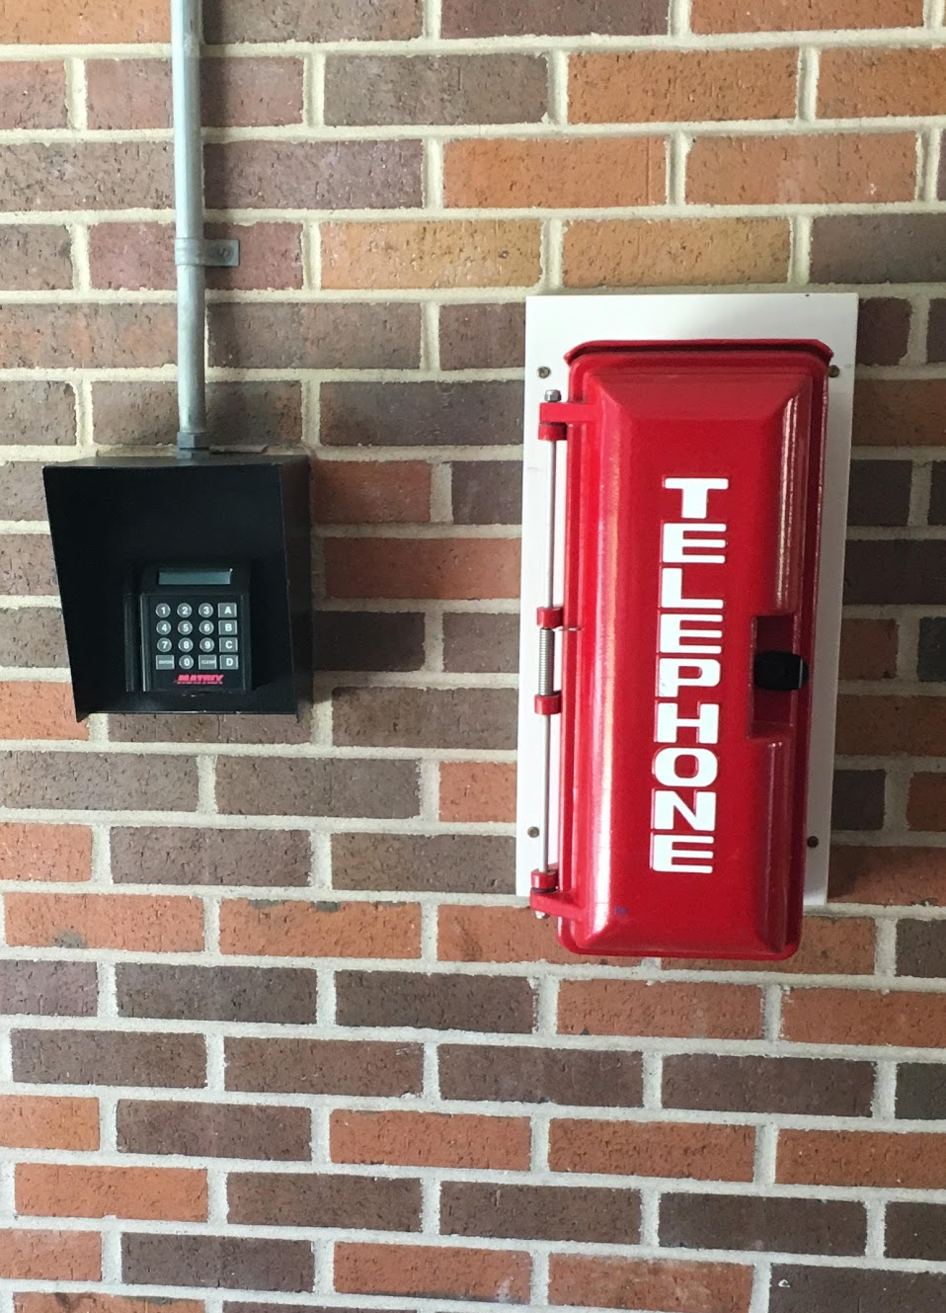
Overview
This project deals with the emergency phones located on the campus of Texas A&M. The emergency phones on campus are extremely important in terms of safety for the students and faculty of the university.
The idea behind the emergency phones is that you are supposed to see one in view wherever you are on the Texas A&M campus. However, this is not the case because there are a lot of “dead zone” areas that do not have one in view. There are many other problems however; several out of the 228+ phones have an issue, the current map showing them as points is outdated, and there are no GPS coordinates on record.

Slide 3
Clients
TAMU Telecommunications:
Geneva Johnson - Gj1147@tamu.edu
Phone call
3/24/17 - Gave Ms. Johnson a summary of our project and recieved feedback of what our product could include to be most helpful for her.
Emailed
3/27/17 - Obtained PDFs of the location descriptions of phones as of 2/20/17 (personally found at least 10 new ones since)
4/26/17 - Gave Ms. Johnson Project update
5/2/17- Product delivery
TAMU Police Communications Coordinator:
Kystina Tran – kystina@tamu.edu
- 3/24/17: Spoke to on phone: Interested in having a copy of the map.
- Made several attempts during the 3/24/17 week: (emails & phone calls) to contact
- Waiting reply to emails and to set up a meeting

Slide 4
General Project Outcomes
This project has generated a user friendly, interactive, online map for our customers that:
Shows a map of the locations of the Texas A&M Emergency phones
Up to date as of April 2017
Include the GPS coordinates of each phone
Gives information about the phone such as if it has a problem that needs a work order or not.
Deliverables that were not integrated into the online map were:
Map showing the “dead zone” areas that could potentially have a new phone
CSV files containing all data collected

Slide 5
Specific Project Deliverables
What we will deliver:
An interactive online map utilizing Google My Map that requires no download showing locations of Texas A&M Emergency Telephones
A view-shed analysis of campus to show where the phones cannot be seen “dead-zones”. (Information given to the customer, not implemented in the map)
The emergency phone’s status updates as of April 2017
(i.e. Dial not working, dead light bulb, etc.)
The latitude and longitude of each emergency phone via online map and CSV files

Slide 6
Tasks Completed
The following tasks were conducted in order to create our product based on our customers’ needs:
Discussed with clients what information would be most beneficial to them
Obtained Campus data (Lidar, shapefiles, DEM)
Obtained outdated Point Data for Emergency phones from TAMU Safety and Support
Manually obtained the GPS points of phones
Performed a viewshed analysis of Blue Light Emergency Phones on campus using Lidar imagery/campus DEM
Displayed the “dead zone” areas in a presentable map
Integrated the Emergency Phones with a campus map
Created an online map of Emergency Phones using Google My Maps

Slide 7
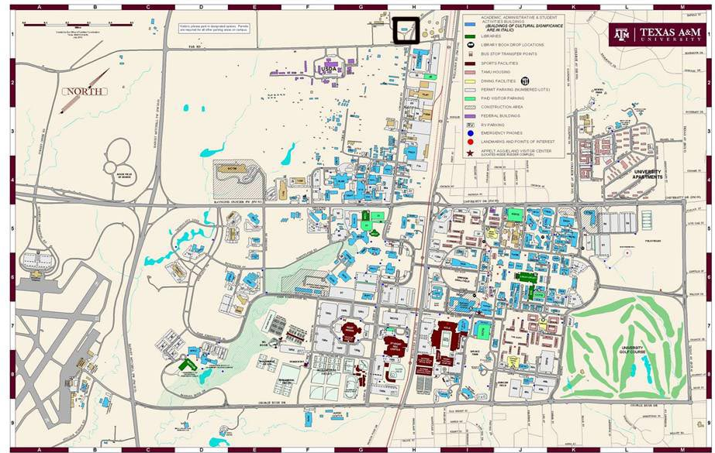
Obtaining Data
This proved to be one of the more challenging task in our map. After speaking with several groups around Texas A&M we were able to obtain the work logs for 219 phones.
All 228 points were taken by hand and recorded. We did this using a hand held GPS.
https://www.google.com/search?q=map+of+texas+a%26m&source=lnms&tbm=isch&sa=X&ved=0ahUKEwjRopHUwM3TAhUE02MKHVt-CacQ_AUICygC&biw=1655&bih=927#imgrc=fOkigxHUI-ptVM:

Slide 8
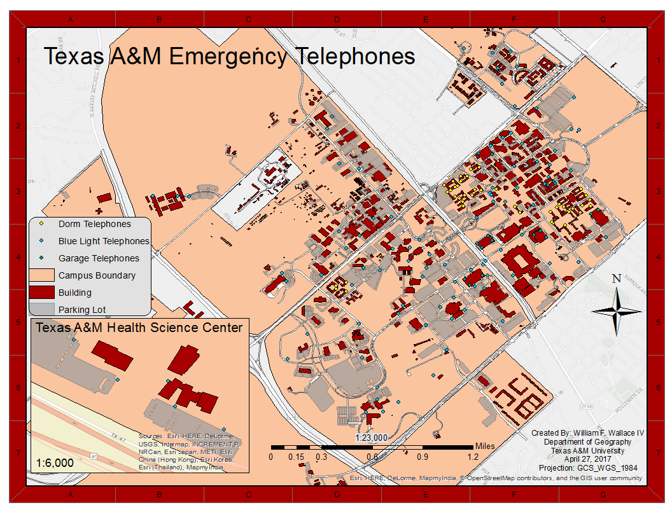

Slide 9
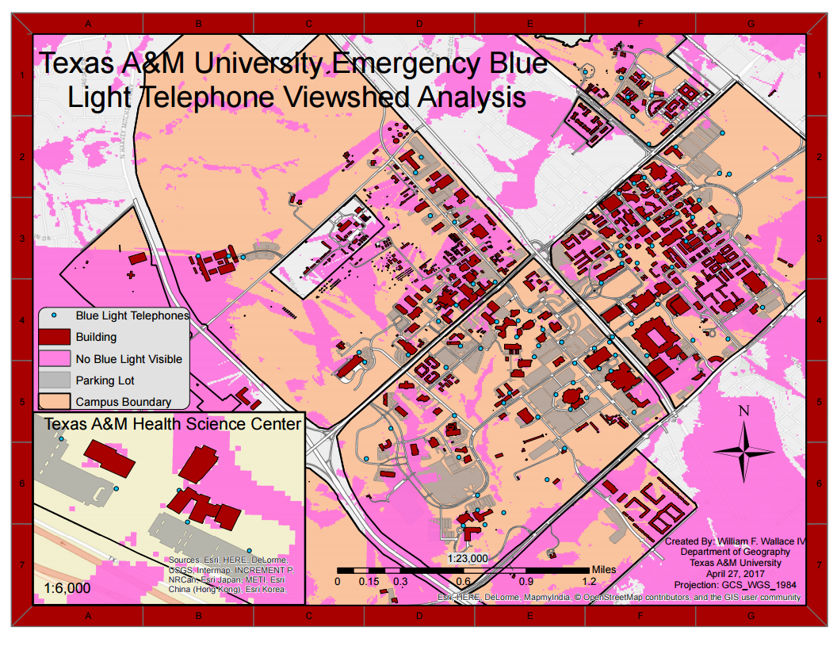

Slide 10
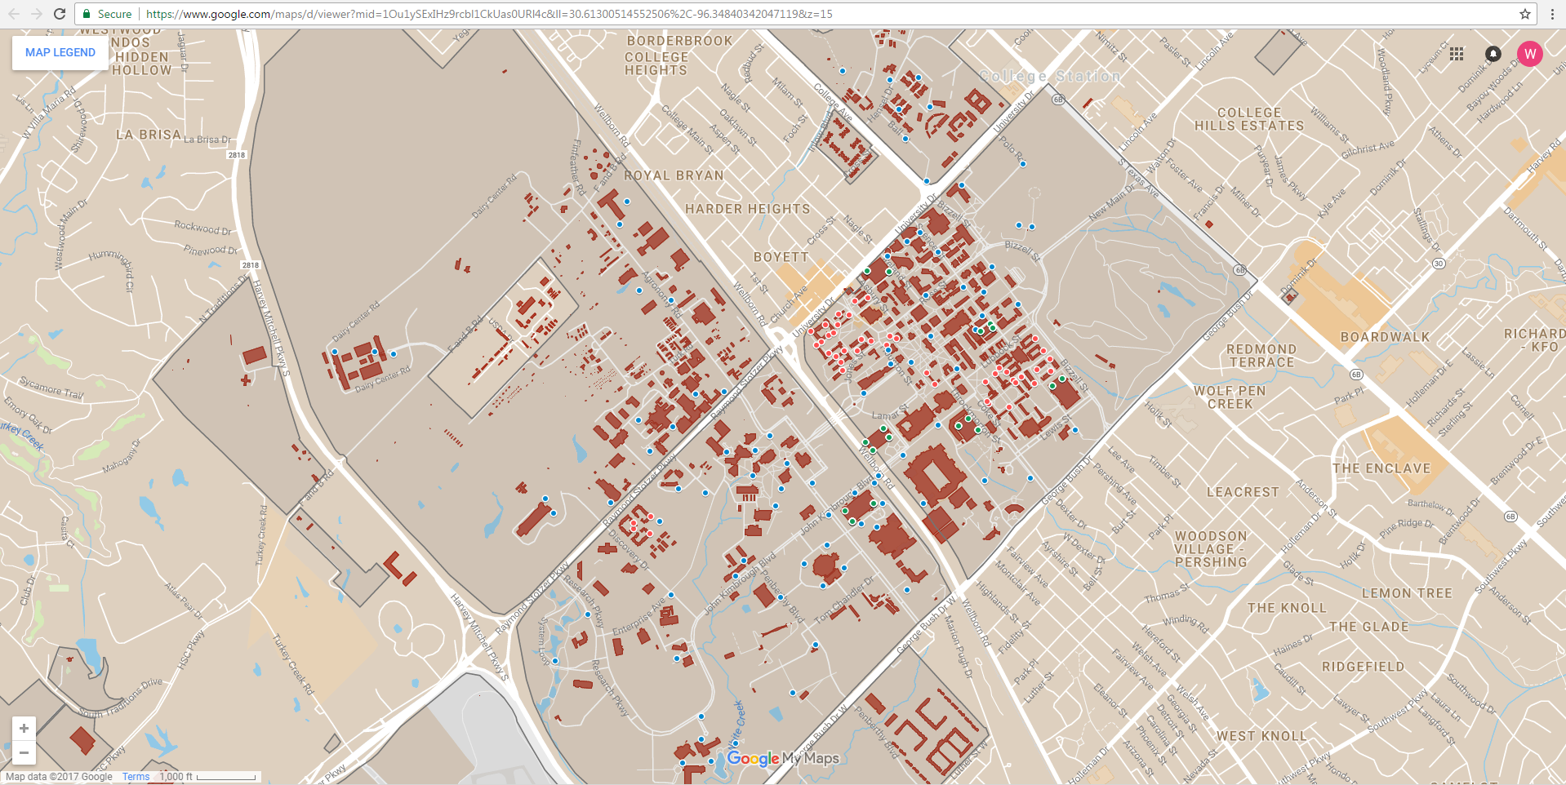
Online Emergency Phone Map
https://www.google.com/maps/d/edit?mid=1Ou1ySExIHz9rcbl1CkUas0URl4c&ll=30.591595028849948%2C-96.3701615&z=12

Slide 11
Overall
By obtaining the GPS coordinates and information about each emergency phone, we can update the current version which is outdated and create a new way to visualize the layout of the phones across campus. The clients will be able to use and incorporate this product with Texas A&M to provide for the public. With the final product, we hope to achieve an accessible and easy way to address problems and find the emergency phones on campus to ensure better safety for A&M’s students, faculty and public.

Slide 12
Customer Feedback
Throughout the data collection and map production process we have tried to keep TAMU Telecommunications up to speed with the project. Geneva Johnson was has been very supportive and helpful during the whole process. The soonest she could meet with to receive our final product was Tuesday, May 2 and she was “very much looking forward to seeing our map!”
TAMU Police Communications Coordinator was initially interested in the data, but when contact was attempted vie phone and email during the production process of the maps and data there was never a response. This led us to believe there was no further interest by Kystina Tran.

Slide 13

Thanks and Gig ‘em! Questions?

